Slide 1
Integrated Health Dashboard
Presented By Data Analytics Team
Kundan Goswami, Sourabh Jain & Umesh Gour
Analytics Solution
www.analyticssolution.in

Slide 2
Objectives of the Project
Create an integrated Health Dashboard, which includes:
HMIS data
Data related to state specific programs running on their respective software which provide data into Hadoop Data Lake
Population data and estimated figures
GIS shape files
Design analytical Dashboards:
Establish District, Block & PHC level analytical dashboards.
At each level, dashboards drill down programs wise.
Top Performer District wise Dashboard.
Least Performer District wise Dashboard.
KPI’s Based on programs performance

Slide 3
Department Specific Indicator
1. HMIS (Hospital Management Information System)
2. HRMIS (Human Resource Information System)
3. MP-Aushadhi (Drug and Consumables Management System)
4. EMMS (Equipment Monitoring and Management System)
5. MP Dialysis Seva (Dialysis Monitoring and Management System)
6. SIAF (State Illness Assessment Fund)
7. PCPNDT (Pre Conception and Pre Natal Diagnostic Techniques)
8. e-Raktkosh (Blood Monitoring and Management System)
9. Clinical License (Private Hospital Registration and Management System)
10. CT-Scan Monitoring and Management System
11. Pathology Services Monitoring and Management System
12. Ayushman Bharat (Coming Soon)

Slide 4
Beneficiary and Citizen Services
Get the below mentioned information as per specific Area / Hospital
1. No of Hospital and their Services
2. Availability of Clinical HR
3. Availability of Drugs and Consumables
4. Availability of Functional Medical Equipments
5. Availability of Blood
4. Information about MP Dialysis Seva
6. Information about State Illness Assessment Fund
7. Information about PCPNDT act.
8. Information about CT-Scan services. Blood
9. Information about Pathology Test
10 Also know about registered Private Nursing Homes / Hospital and their Services

Slide 5
Metadata details
Metadata:
OrgUnit hierarchy upto the Sub health Center level
Data elements
Data sets
Validation rules
Program wise indicators

Slide 6
Data Import Process
Following steps were adopted for data importing
Data imported from application data to Hadoop Data Lake – Sqoop incremental Import.
The process of import included:
Compiling program –wise Application data- month wise (or as required) and Import the data
Verifying/ testing data imported data on random basis

Slide 7
Data Analytical tools
Create comparative tables for analyzing data across different organizational units and periods.
Data Visualizer – Create graphs and charts for analyzing data across different programs, units and periods.

Slide 8
Power BI Dashboard
Two predominant types
By levels - Three levels– District, Block & Health Institutes
By programs at each level – Online and offline programs
Capability of dashboard
Visualize indicators by programs and levels
Interpretation of data/ indicators
Possibility of including other data – survey data, infrastructure data; Census data for richer analysis

Slide 9
Data Visualization Tool
Power BI Dashboard
An easy to read, real-time user interface, showing a graphical presentation of the current status (snapshot) and historical trends of any program's key performance indicators (KPIs) to enable instantaneous and informed decisions to be made at a glance.

Slide 10
Dashboard Capabilities
Supports regular on-time check of key program aspects.
Quickly monitor program progress over a period.
Quick assessment of performance of all the districts/blocks/ facilities at one platform.
Dashboard allows sharing of data interpretations with different user groups to evaluate and better understand data and comment on the shared interpretations.

Slide 11
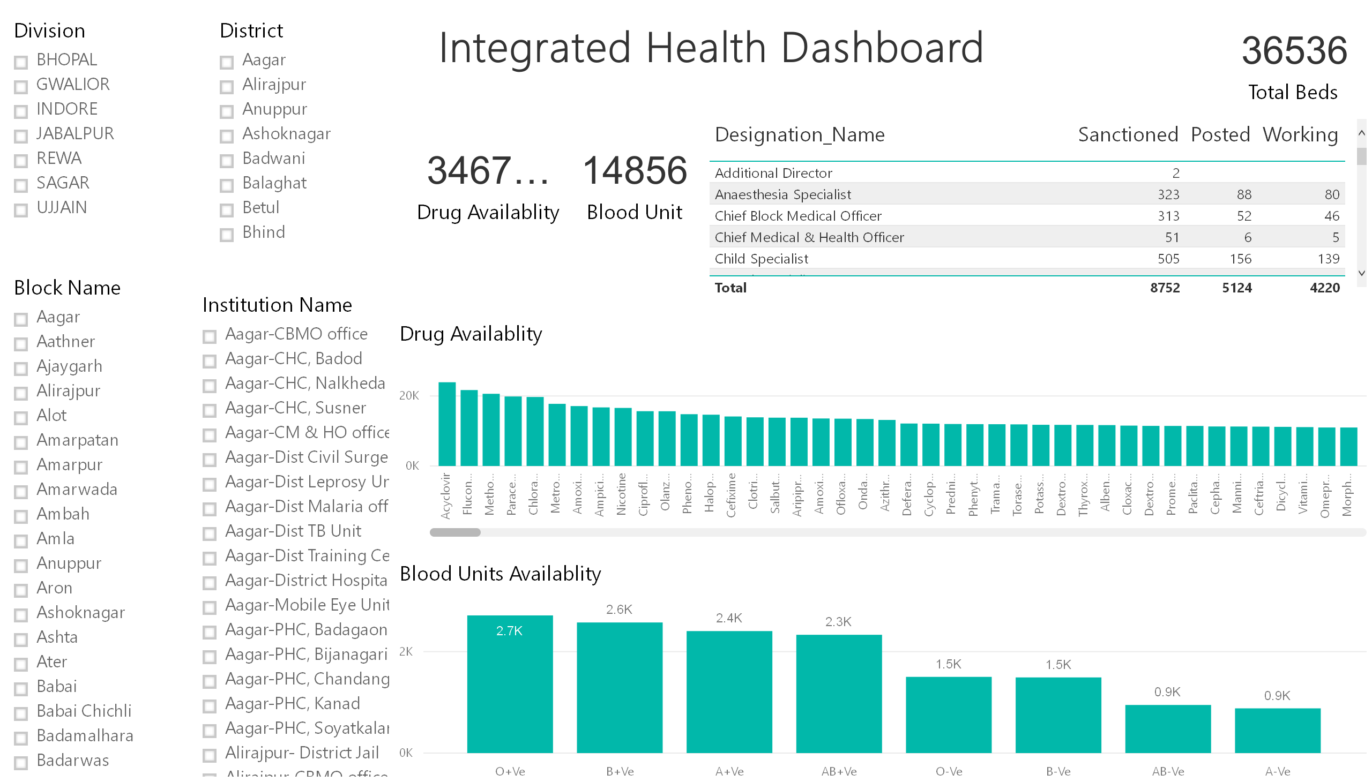

Slide 12
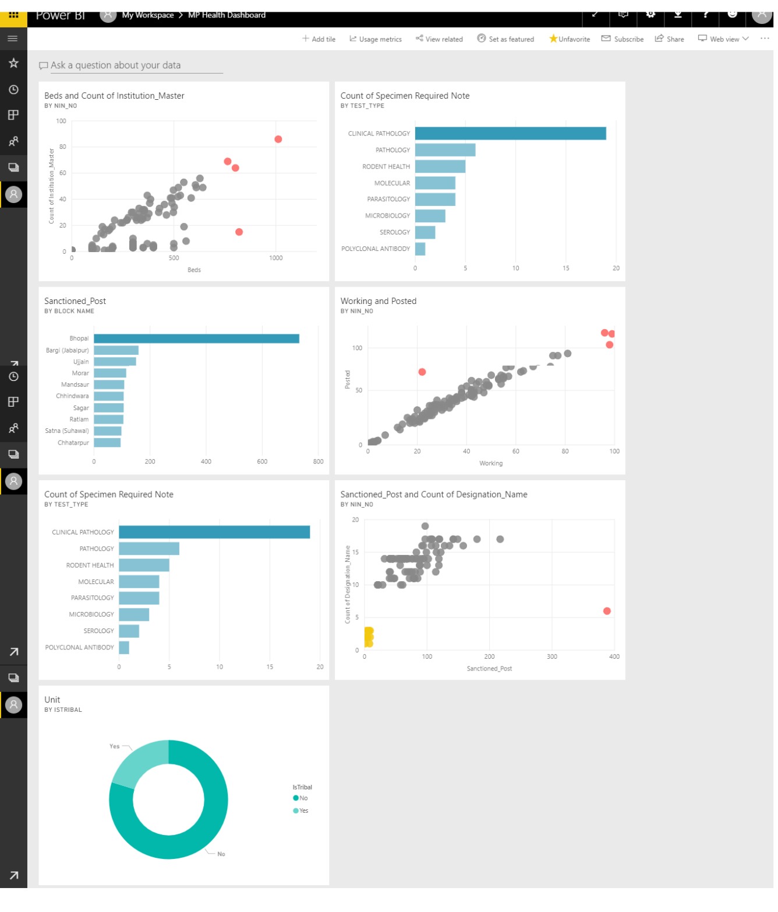

Slide 13
Thank you

